Slide 2
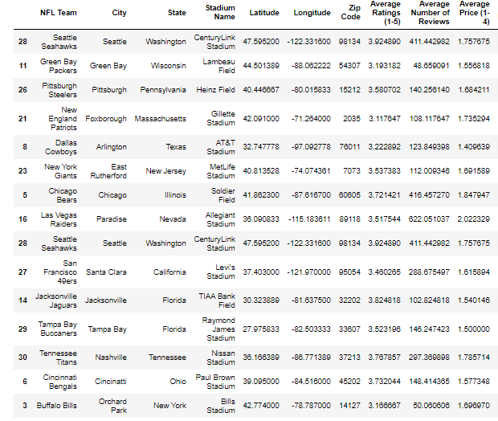
Comparing Restaurants by Team/City Popularity
We compared the data pulled from for the most popular NFL franchises among fans, the most popular cities for people to visit that had NFL teams, and then least popular NFL franchises.
Most Popular Teams:
Dallas Cowboys
New England Patriots
Pittsburgh Steelers
Green Bay Packers
Seattle Seahawks
Most Popular Cities:
New York
Chicago
Las Vegas
Seattle
San Francisco
Least Popular Teams:
Jacksonville Jaguars
Tampa Bay Buccaneers
Tennessee Titans
Cincinnati Bengals
Buffalo Bills

Slide 3
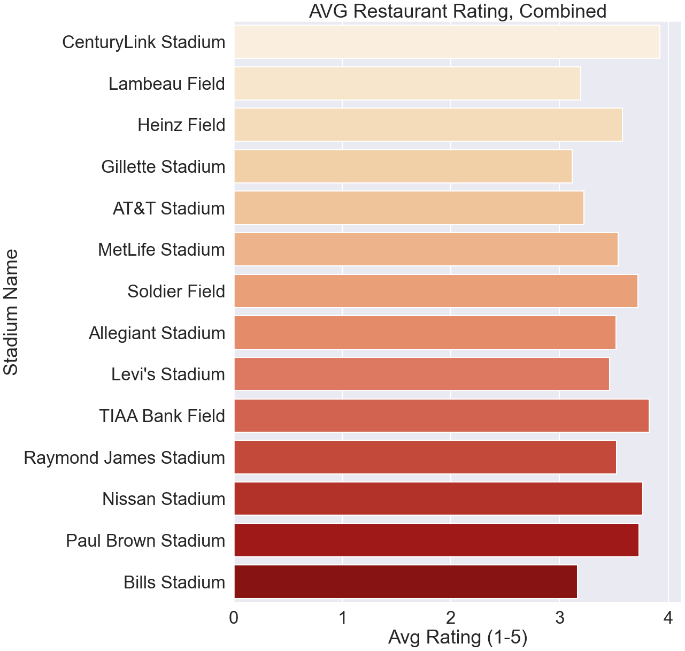
Comparing Ratings by Team/City Popularity
In this chart, we are showing the team’s stadiums and the average restaurant rating that each has in a 3000 mile radius around it.
CenturyLink Stadium (3.92, Seattle Seahawks) has the highest rating while Gillette Stadium (3.12, New England Patriots) had the lowest.
The average rating for each team in this part of the study was 3.55.

Slide 4
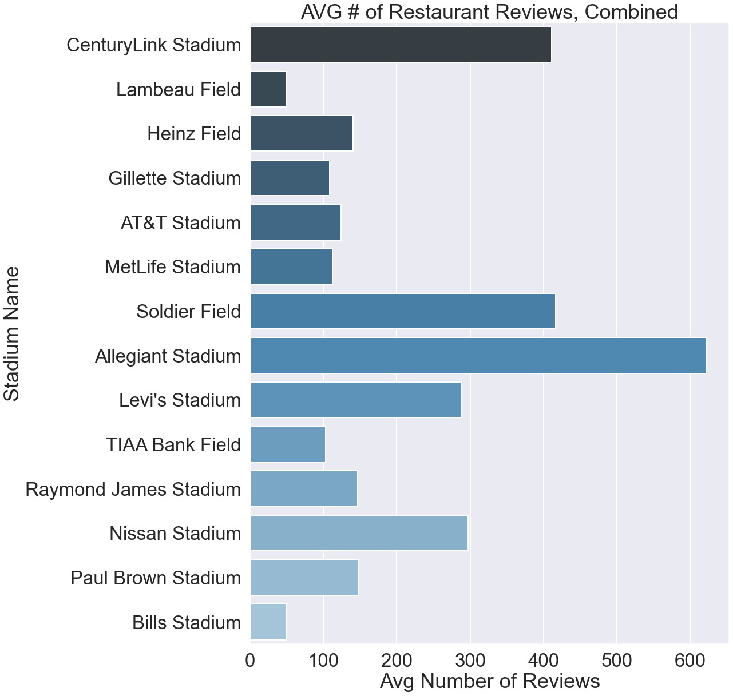
Comparing Number of Reviews by Team/City Popularity
Here is a comparison of the average number of reviews around each stadium.
Allegiant Stadium (Las Vegas), Soldier Field (Chicago), CenturyLink Stadium (Seattle) all had large numbers of reviews left on average.
This could potentially be due to their popularity as tourist spots since all 3 are included in the list of America’s popular travel destinations.

Slide 5
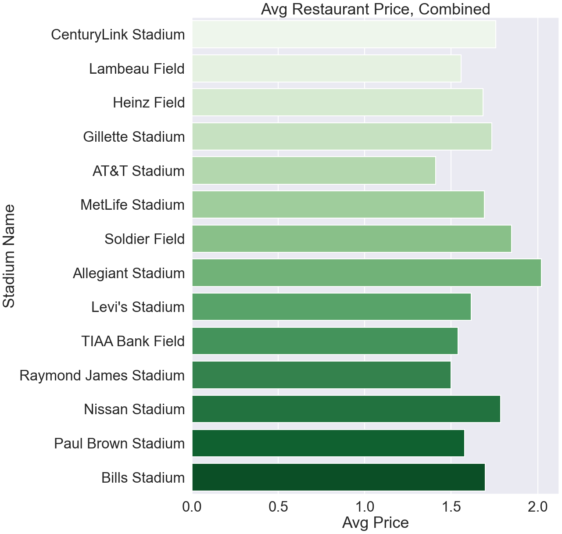
Comparing Price by Team/City Popularity

